Slide 1
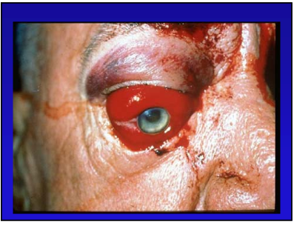
Orbital hematoma
Orbital hematoma
Dr. Natalia 2nd year Resident

Slide 2
OUTLINE
Definition
Causes
Risk factor
MECHANISM/PATHOPHYIOLOGY
Diagnosis
Differential Dx
Treatment
Prognosis

Slide 3
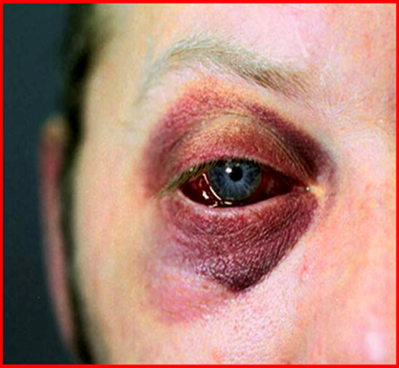
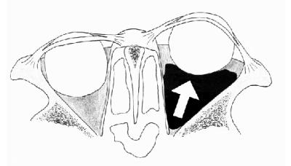
Orbital hematoma definition
Orbital hematoma is defined as a collection of blood inside orbit that results from rupture of an artery or vein
Hematoma formation can cause:
The pressure increase rapidly
Damage to sensitive structure inside the orbit.
Orbital hematoma is defined as a collection of blood inside orbit that results from rupture of an artery or vein
Hematoma formation can cause the pressure in the increase rapidly , cause damage to sensitive structure inside the orbit.
Notes:
Increase in orbital volume and orbittal pressurecan restrict the vascular supply to the globe, vision loss from optic nerve damage/retinol ischemia
The orbit is composed of 7 bones that enclose all but the anterior aspect. Here, the globe obstructs the opening to the bony orbit (Fig. 1). Following trauma, the presence of hemorrhage, foreign body or edema can increase retrobulbar pressure. The orbit compensates through proptosis, but the medial and lateral canthal tendons, which attach the eyelids to the orbital rim,2 limit the forward movement of the globe. As proptosis is restricted, the orbital pressure increases and impedes the optic nerve's vascular supply.3 If IOP exceeds central retinal artery pressure, retinal ischemia results.2 In such situations, timely LCC can save visual function. Table 1 summarizes the relevant indications and contraindications for LCC.

Slide 4
Orbital hematoma causes
Causes of orbital hematoma Post traumatic Retrobulbar Hmg
Facial trauma
Orbital fracture
Post anesthesia Retrobulbar Hmg
Peribulbar orbital injection
Retrobulbar orbital injection
Spontaneous Retrobulbar Hmg
Orbital vascular anomalies
Tumor
Systemic abnormality ( coagulopathy, uncontrolled HTN , septicemia , sick cell pt)
Notes:
Report esimate the incident of signecant retrobulbar hmg 1-3%

Slide 5
Orbital hematoma causes
Post surgical
After repair of Orbital fracture
After cosmetic or reconstructive eyelid surgery
After endoscopic sinus surgery
After other surgeries: strabismus, dacryocystectomy ….

Slide 6
Orbital hematoma risk factors
Risk factor to development of postoperative retrobulbar hemorrhage
Anticoagulant medication
Valsalva manuever
Vascular disease
Coagulopathy
Dyscrasia(thrombocytopenia,cirrhosis,leukemia)
Increase activity
HTN

Slide 7
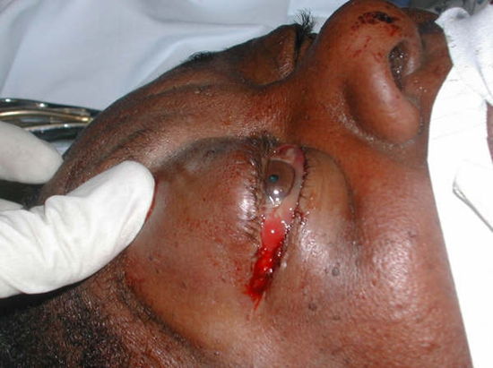
Orbital hematoma MECHANISM/PATHOPHYIOLOGY
Orbital hemorrhage result orbital Compartment Sd Following artery injury Present Hmg/hematoma Increase Intra orbital pressure & orbital volume Causes compression Optic nerve & blood supply RESULT:
Ischemic optic neuropathy
Direct compressive optic neuropathy
Central retinal artery occlusion In
Retinal vascular ischemia
Notes:
Retrobulbar hmg result in an orbital com sd

Slide 8
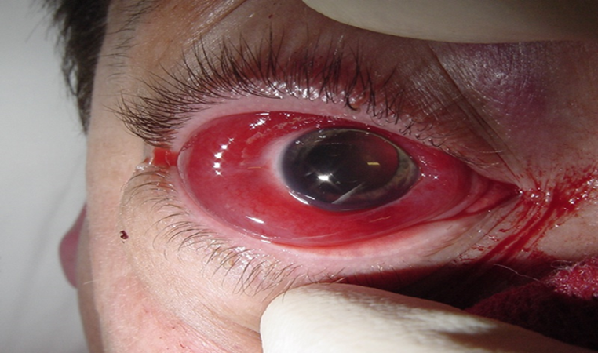
Orbital hematoma Diagnosis
Symptoms
Hx of trauma or surgery
Pain
Decreased vision
Diplopia
Nausea
Vomiting
Sign
Proptosis with resistance to retropulsion
Ophthalmoplegia
Increase IOP
Afferent pupillary defect
Periorbital ecchymosis
Subconjuctival Hmg
Optic disc or retina pallor
Notes:
Venous retrobulbar hmg usualy self lmited and tend spred slowly ,they often donot require treatment
Arterial retrobulbar hmg ocurs more repidly, ond associated (sign)

Slide 9
Orbital hematoma Diagnosis
Examination
Visual acuity and visual fields — decreased with dyschromatopsia (signs of optic neuropathy)
External exam — Proptosis with resistance to retropulsion, diffuse subconjunctival hemorrhage, tight eyelids (rock hard) with ecchymosis and chemosis.
Extra ocular eye movements — limited extra ocular motility
Pupils — RAPD.
Tonometry — increased intraocular pressure (IOP)
Funduscopy — papilledema from compressive optic neuropathy may be present, retinal artery or vein occlusion.

Slide 10
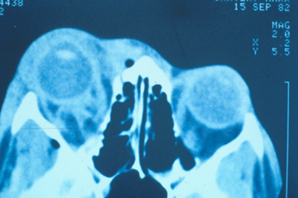
Orbital hematoma diagnosis
Imaging study to confirm the diagnosis
CT scan orbit (axial and coronal views) can confirm the diagnosis — but if vision is threatened treat first
MRI scan
Notes:
CT scan and MRI doing when visual function stabilized

Slide 11
Orbital hematoma differential Dx
Orbital cellulitis
Orbital fracture
Rupture globe
Carotid –cavernous fistula
Varix
Lymphangioma
Spontaneous retrobulbar Hmg
Notes:
1.Fever ,proptosis,chemosis,pain,limination EOM,also follow trauma but ussually not as acutely
2.Limited eom enophtalmos or proptosis may be present
3.Sub cong hmg .edema
4.Follow trauma,pulsating exophthalmos conguct vx ,chemosis,increse iop
5.Proptosis w valsava manever not use acutely no hx of trauma
6.Acute proptosis,echimosis,limit eom
7.Anicoagulatt from systemic dz

Slide 12
Orbital hematoma medical treatment
Orbital compartment syndrome is an ocular emergency whose prompt Dx & Tx essential to prevent blindness. Lowering intraorbital and intraocular pressure protecting optic nerve from damage
Medical treatment:
Ice compresses (20 min on,20 min off )
Corticosteroids IV (decrease inflammation , edema , provide neuroprotection to optic nerve )
Hyperosmotic agent (Mannitol 20% IV 1-2g/kg over 45min)
CAI(acetazolamide 500mg IV)
Topical beta-blocker (Timolol 0.5% or levobunolol 0.5%)
AC parasentesis(use lower IOP quickly)
AB (e.g.,fracture )
Notes:
By Stabilized cell membranes
Aqueous supressant

Slide 13
Orbital hematoma surgical treatment
Surgical treatment
Emergency lateral canthotomy and inferior cantholysis must be performed for relief pressure on the eye
Absolute indication
Retrobulbar hemorrhage resulting in acute loss of VA
Proptosis
IOP greater than 40 mm Hg
Afferent pupillary defect
Ophthalmoplegia
Cherry-red macula
Optic nerve head pallor
Severe eye pain
Contraindication
Globe rupture
Notes:
And can save visual function

Slide 14
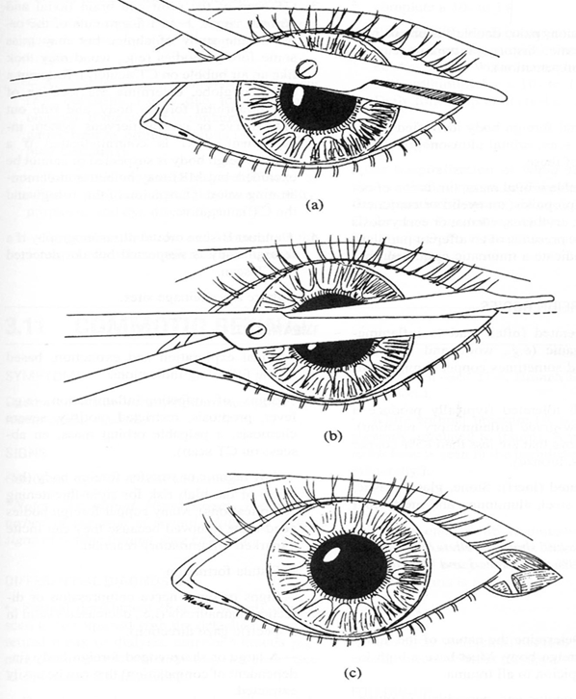
Orbital hematoma Surgical treatment
Technique of Lateral Canthotomy
Clean with 5% Betadin
Subdermal injection Lidocaine 2% with Epinephrine
Clamp small hemostat horizontally across lateral canthus
With blunt tipped scissors (Wescott or Stevens) , cut horizontally from lateral angel of eyelid to the bone margin
Inferior Cantholysis

Slide 15
Orbital hematoma Surgical treatment
Inferior Cantholysis
Cut inferior crus of lateral canthal tendon with scissors pointed inferoposterioly to release it completely from its attachments
Upon proper cantholysis lower lid should fall away from lid margin
If IOP remains elevated after inferior cantolysis the superior crus of lateral cantal ligm may be released in similar fastion

Slide 16
Orbital hematoma Surgical treatment
Complication:
Ptosis
Injury lacrimal gland
Injury lacrimal artery
Infection
Bleeding
Ectropion
Retinal Ischemia

Slide 17
Orbital hematoma prognosis
Acute orbital compartment Sd with VA loss associated with poor prognosis
Emergent decompressive surgery ( lateral canthotomy & inferior cantholisis)may save sight in pt with severe symptom
Irreversible visual loss can be expected with retinal ischemia that lasts longer than 120 min.

Slide 18
Reference
Will eye manual sixth edition
Jack Kanski seventh edition
Ocular trauma James T.Banta,MD2007
AAO,volume 7 ,Orbital,Eyelid and Lacrimal System 2011-2013.
Picture from internet

Slide 19
THANK YOU FOR YOUR ATTENTION

